Slide 1
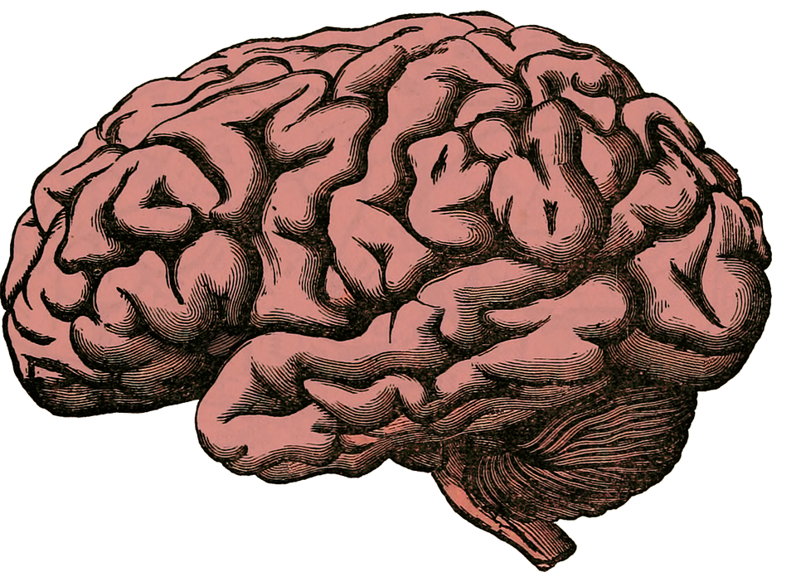
MENTAL
IT’S TIME FOR…
MATH!
BASIC ALGEBRA REVIEW!
LESSON #1: BEGINNER LEVEL (+ & - ONLY)
JACOB M. LIGHTBODY © 2016

Slide 2
DIRECTIONS: TRY TO SOLVE THE FOLLOWING PROBLEMS USING MENTAL MATH. CLICK ON YOUR ANSWER CHOICE ONCE YOU’VE MADE UP YOUR MIND.

Slide 3
REMINDER: YOU MAY FIND IT HELPFUL TO USE THE ANSWER CHOICES AS HINTS.

Slide 4
1.) USE MENTAL MATH TO FIND THE ANSWER.
A.) n = 7
3 + n = 10
B.) n = 13
C.) n = 5
D.) n = 8

Slide 5
GO BACK!
GO FORWARD!

Slide 6
You got it!
GO FORWARD!

Slide 7
2.) USE MENTAL MATH TO FIND THE ANSWER.
A.) x = 12
x - 4 = 12
B.) x = 10
C.) x = 16
D.) x = 8

Slide 8
GO BACK!
GO FORWARD!

Slide 9
You got it!
GO FORWARD!

Slide 10
3.) USE MENTAL MATH TO FIND THE ANSWER.
A.) y = 11
12 + y = 20
B.) y = 9
C.) y = 8
D.) y = 6

Slide 11
GO BACK!
GO FORWARD!

Slide 12
You got it!
GO FORWARD!

Slide 13
4.) USE MENTAL MATH TO FIND THE ANSWER.
A.) n = 7
19 - n = 11
B.) n = 8
C.) n = 9
D.) n = 10

Slide 14
GO BACK!
GO FORWARD!

Slide 15
You got it!
GO FORWARD!

Slide 16
5.) USE MENTAL MATH TO FIND THE ANSWER.
A.) y = 6
5 = 4 + y
B.) y = 5
C.) y = 3
D.) y = 1

Slide 17
GO BACK!
GO FORWARD!

Slide 18
You got it!
GO FORWARD!

Slide 19
6.) USE MENTAL MATH TO FIND THE ANSWER.
A.) n = 6
3 = 9 - n
B.) n = 3
C.) n = 12
D.) n = 7

Slide 20
GO BACK!
GO FORWARD!

Slide 21
You got it!
GO FORWARD!

Slide 22
7.) USE MENTAL MATH TO FIND THE ANSWER.
A.) x = 8
16 + x = 20
B.) x = 4
C.) x = 24
D.) x = 6

Slide 23
GO BACK!
GO FORWARD!

Slide 24
You got it!
GO FORWARD!

Slide 25
8.) USE MENTAL MATH TO FIND THE ANSWER.
A.) x = 2
6 = x + 4
B.) x = 4
C.) x = 8
D.) x = 10

Slide 26
GO BACK!
GO FORWARD!

Slide 27
You got it!
GO FORWARD!

Slide 28
9.) USE MENTAL MATH TO FIND THE ANSWER.
A.) n = 11
7 - n = 4
B.) n = 15
C.) n = 3
D.) n = 12

Slide 29
GO BACK!
GO FORWARD!

Slide 30
You got it!
GO FORWARD!

Slide 31
10.) USE MENTAL MATH TO FIND THE ANSWER.
A.) n = 9
12 = n - 4
B.) n = 16
C.) n = 20
D.) n = 10

Slide 32
GO BACK!
GO FORWARD!

Slide 33
You got it!
GO FORWARD!

Slide 34
TO BE CONTINUED…

